Slide 1
Switch Case Statement -
The C++ switch statement executes one statement from multiple conditions. It is like if-else-if ladder statement in C++.
Syntax –
switch(expression)
{
case value1: //code to be executed; break;
case value2: //code to be executed; break;
......
default: //if all cases are not matched; break;
}

Slide 2
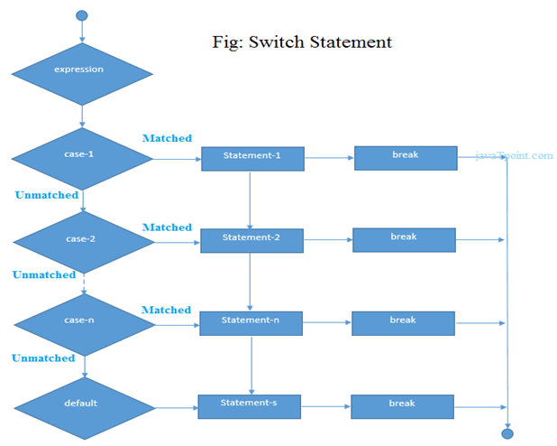

Slide 3
Example –
#include<iostream.h>
#include<conio.h>
void main ()
{
int num;
cout<<"Enter a number to check grade:";
cin>>num;
switch (num)
{
case 10: cout<<"It is 10"; break;
case 20: cout<<"It is 20"; break;
case 30: cout<<"It is 30"; break;
default: cout<<"Not 10, 20 or 30"; break;
}
}

